Slide 1

What is Big data, Artificial, Intelligence and Data science?
Proposed by:
Cedric Lontsi
cedriclontsi@gmail.com

Slide 2
Plan
What is Big Data?
What is Machine Learning (ML)?
Steps to setting up a ML project
What is Deep Learning(DL)?
What is Data science?
The tools of the data scientist
What is Artificial Intelligence(AI)?

Slide 3
What is Big data?
Big data
Volume
Velocity
Value
Variety
Veracity
Definition: Large volume of data in a variety of formats from a diverse set of reliable sources with enormous velocity and potential to add value.

Slide 4
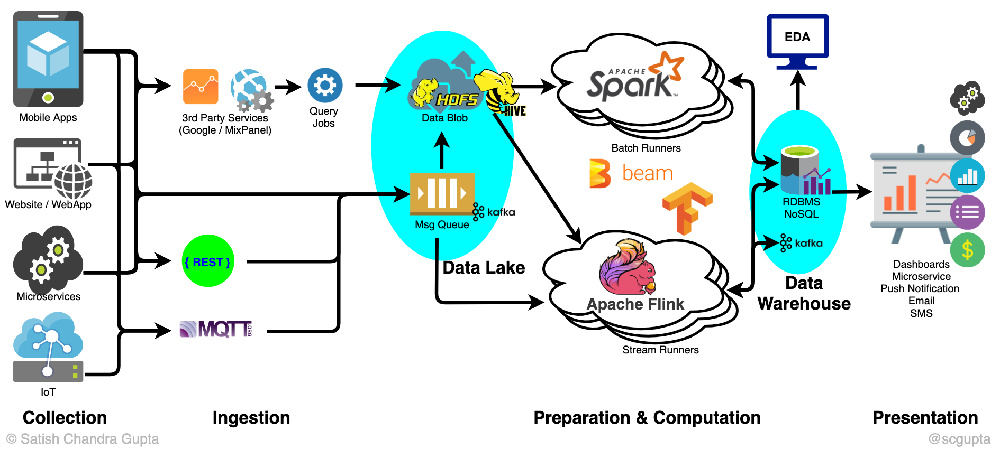
Big data Pipeline
Source :ichi

Slide 5
Type of data in Big data
Structured data
(example: table)
Semi-structured data
(example: XML,JSON)
Non-structured data
(example: image, video, son)

Slide 6
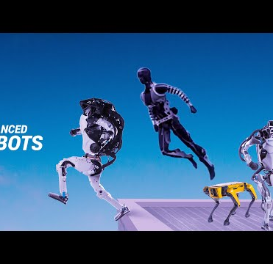
What is AI?
Artificial intelligence (AI) is the field of computer science that aims to design machines capable of acting intelligently.
“Human intelligence exhibited by Machines”

Slide 7


Machine Learning
Proposed by:
Cedric Lontsi
cedriclontsi@gmail.com

Slide 8

Definition
“Machine Learning is the field of study that gives computers the ability to learn without being explicitly programmed.” Arthur Samuel, 1959

Slide 9

What is the aim of Machine Learning?
Design programs that learn from data and will be able to generalize to new data inputs of the same characteristics as what it has learned.

Slide 10

Algorithms of Machine Learning

Slide 11

Supervised learning
The machine knows in advance the target variable to predict: There are two main groups:
Regression algorithms: linear regression
Classification algorithms: decision trees, random forests, SVM, Bayesian model
Type of problem: Fraud detection, churn, house cost prediction, bushfire prediction, Cancer prediction,etc.

Slide 12

Unsupervised learning
The machine learns by itself. There are two types of algorithms: There are two main groups:
Clustering: K-Means
Hierarchical classification
Factor analysis (PCA, SVD, etc)
Type of problem: Community detection, visualization of large amounts of data, clustering

Slide 13
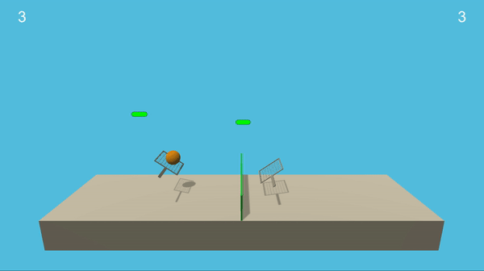
Reinforcement learning
The machine learns from its own mistakes. Example: Online games

Slide 14
General limitations of ML algorithms
In the presence of very large amounts of data, ML models sometimes prove inadequate.
Some types of problems cannot be solved efficiently with classical ML models, e.g. object detection, translation, facial recognition, pattern extraction in textual, musical or video content, etc.

Slide 15

What is Deep learning?
Proposed by:
Cedric Lontsi
cedriclontsi@gmail.com

Slide 16
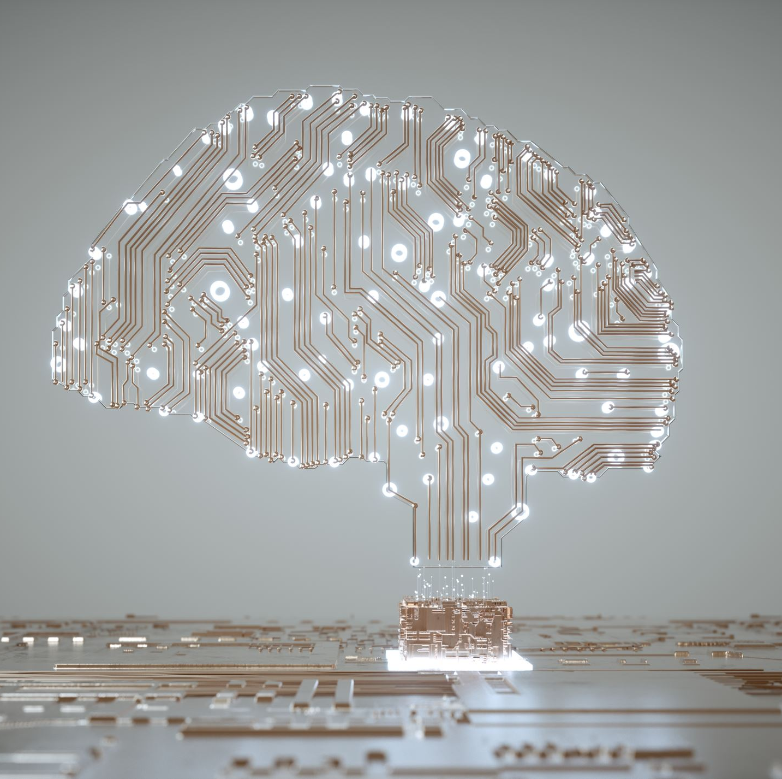
Definition
Deep learning is a sub-field of machine learning that concerns algorithms inspired by the structure and function of the brain called artificial neural networks

Slide 17
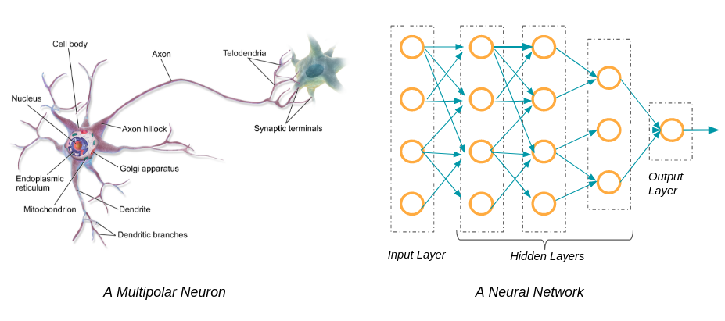
Biological neuron and artificial neuron
Source :datakeen

Slide 18
Characteristic of Deep Learning algorithms
Takes a very large amount of data as input
Requires a fairly powerful hardware resource (powerful computer)
Training the model can be very time consuming (hours or days)

Slide 19
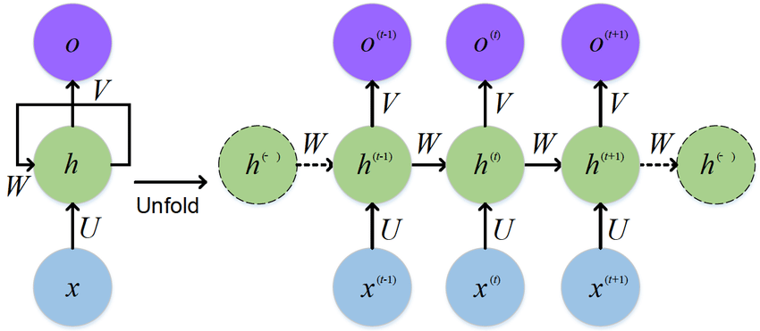

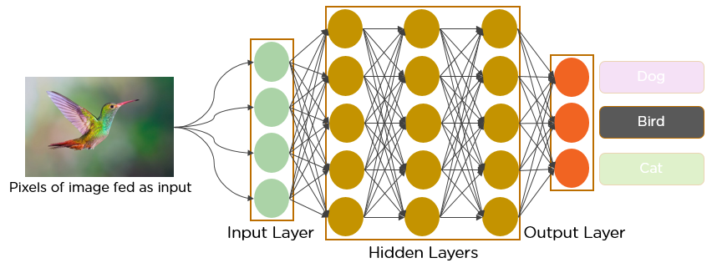
Algorithms of deep learning
Recurrent Neural Network(RNN)
Deep Neural Network(DNN)
Source: Researchgate
Source :Researchgate
Convolutional Neural Network(CNN)
Source: analyticsvidhya

Slide 20

Convolutional Neural Networks: CNN
Transforms an image through a series of convolutions for prediction or classification.
Problem solved: Facial recognition, loan recognition, object detection,
Object classification, anomaly detection in humans and plants.

Slide 21
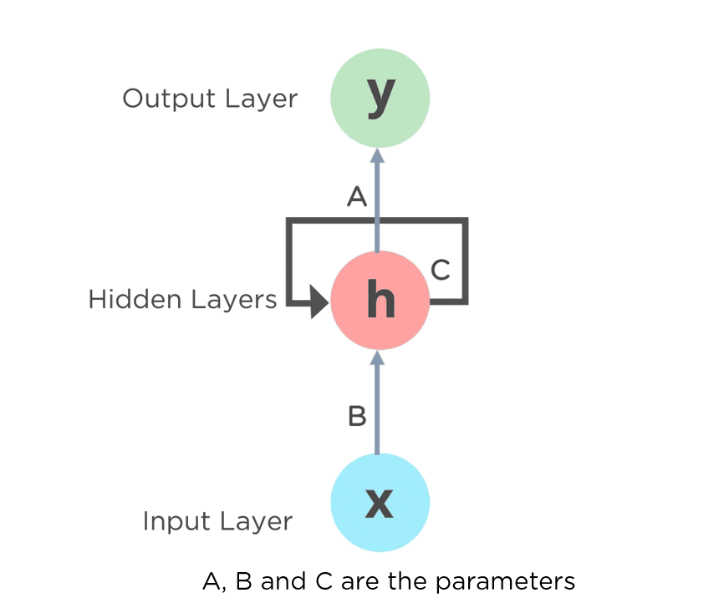
Recurrent Neural Network:RNN
Uses reasoning from previous experiences to inform future events.
Application: Text translation, speech recognition, translate song to text, song classification, text prediction and classification, extraction of insight in a video.

Slide 22

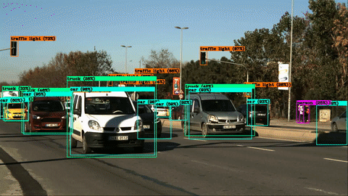


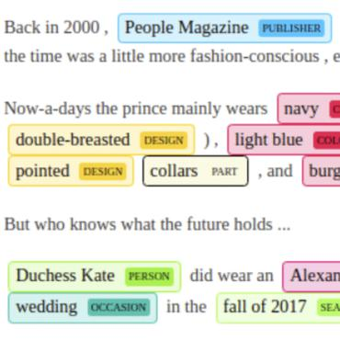
Application of Deep learning algorithms

Slide 23
Intelligence artificielle vs. Machine Learning vs. Deep learning
Intelligence Artificielle
Machine Learning
Deep learning

Slide 24
What is Data science?
Proposed by:
Cedric Lontsi
cedriclontsi@gmail.com

Slide 25

What is data science?
The advent of Big Data has led to new data analysis techniques and a new discipline.
Data science is a discipline that aims to explore and analyse raw data in order to produce knowledge useful for decision-making.
Data science thus enables the detection of insights within data.

Slide 26

Definition
An interdisciplinary field that uses scientific methods, processes, algorithms and systems to extract knowledge from large volumes of data.

Slide 27
Analytical approaches in data science
Descriptive analyse
Synthetizing and analyzing historical data to derive useful knowledge for decision-making. Answers the question "What is going on?
Prescriptive analysis
Synthetize and analyze historical data to explain and counteract a phenomenon. Answer the question "Why is this going to happen?" and "What can be done?"
Predictive analysis
Synthetizing and analyzing historical data in order to predict a trend. Answers the question: "What will happen?

Slide 28
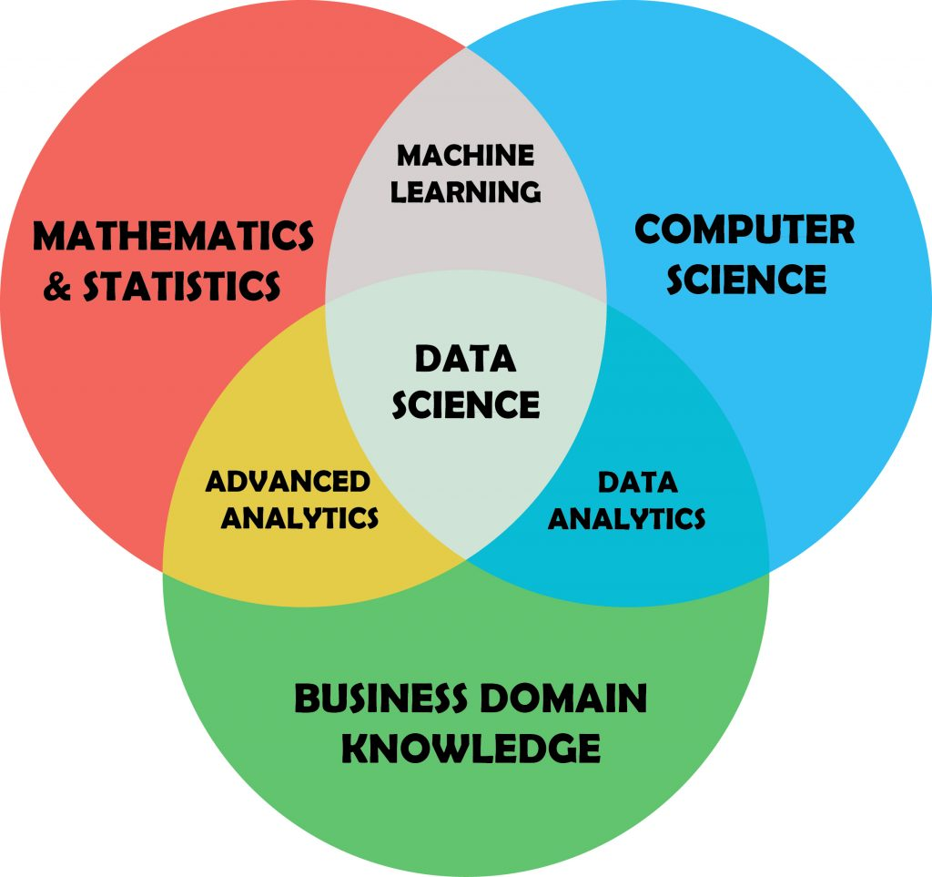
Interaction domains with Data science

Slide 29
What is a Data product?
It is an asset that relies on data and processes it to generate results using an algorithm.
Example: Recommendation engines that use user data to propose personalised content (Netflix, Facebook, Amazon).
A data product is therefore equivalent to a deployed Machine Learning model.

Slide 30











Some tools for Data scientist

Slide 31
Data science project life cycle
Proposed by:
Cedric Lontsi
cedriclontsi@gmail.com

Slide 32
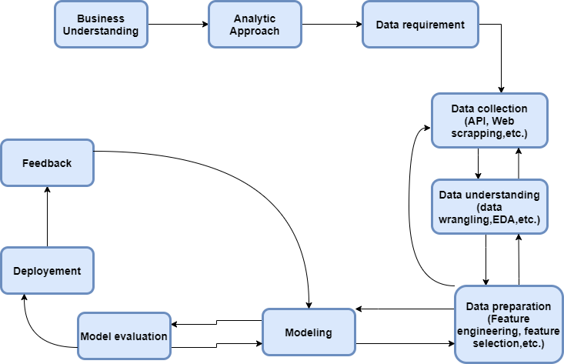
Data science project life cycle

Slide 33

Thanks you
Proposed by:
Cedric Lontsi
cedriclontsi@gmail.com

